Slide 1

E- School
A School Management System

Slide 2

Actor
Student
Course Teacher
Class Teacher
Parents
Headmaster
System Admin (Headmaster, Course Teacher assigned by Headmaster)

Slide 3
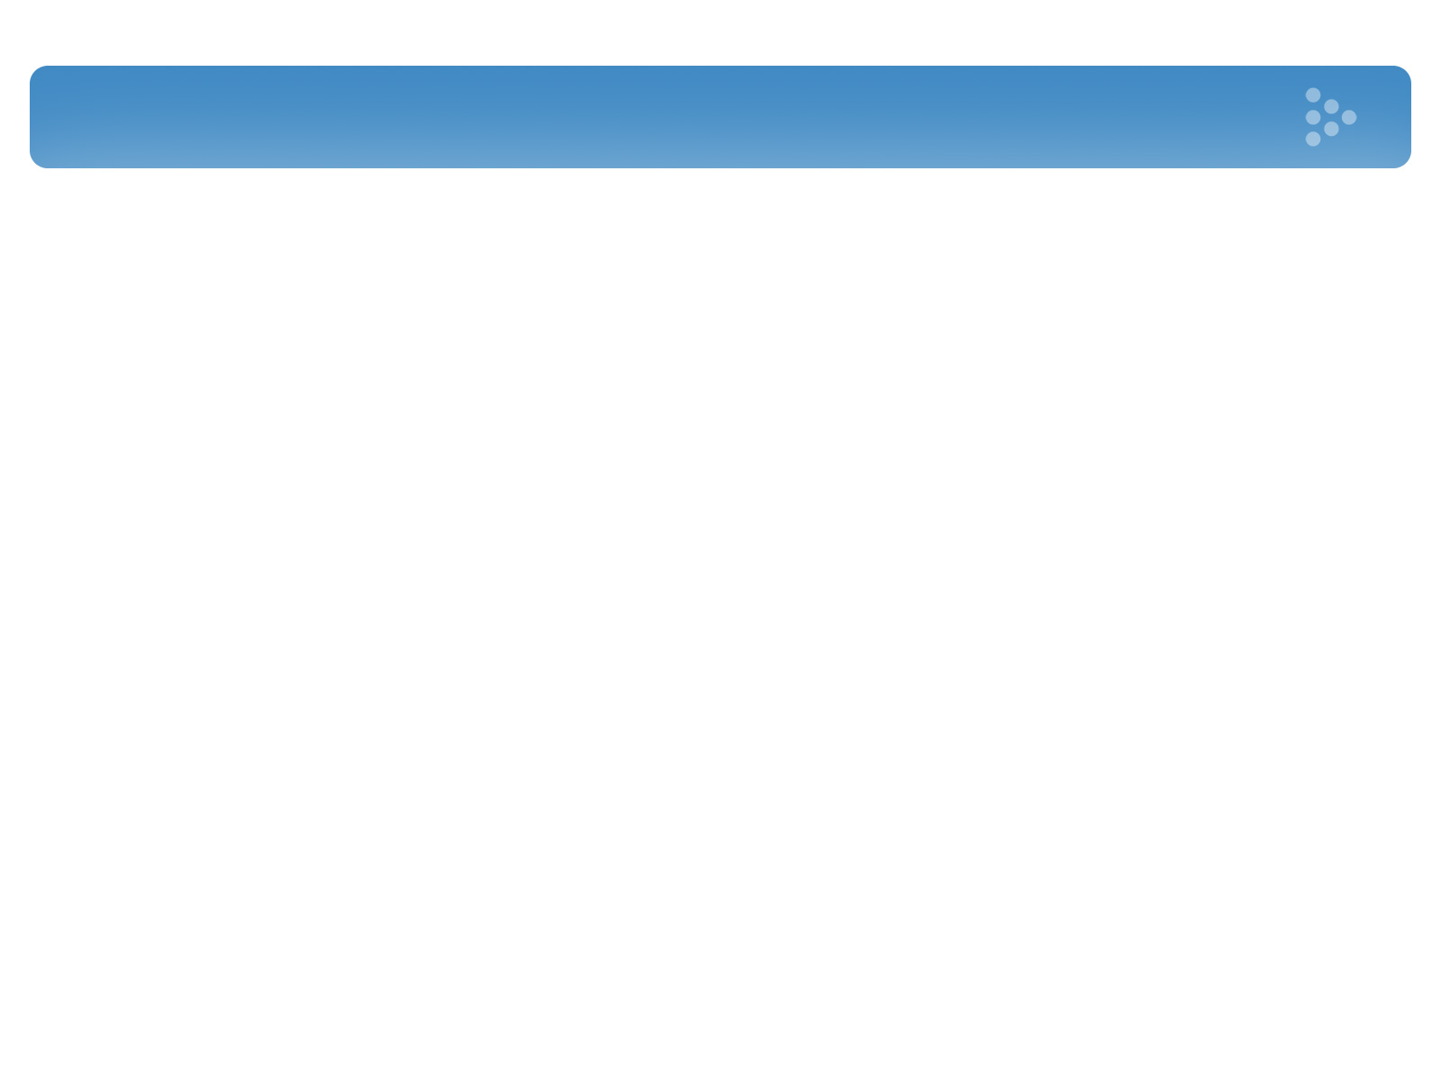
Actor’s Glossary
Actor | Short Key | Activity Scope
Student | ST | Viewing notice, routine, syllabus, result, fees status of thyself.
Course Teacher | CT | Adding class test schedule, syllabus & mark, giving feedback, inserting exam mark, view duty roster,
Class Teacher | CLT | Adding details of students, making result, giving feedback, adding attendance of students, issuing admit card.
Parents | PT | Viewing notice, routine, syllabus, result, fees status of their children, viewing notice and getting in contact with teacher.
Headmaster | HM | Approving result, appointing system admin, tracking fees status
System Admin | SA | Adding & deleting user, updating user role & details, assigning course teacher and class teacher, preparing and sending class & exam routine, preparing duty roster, inserting notice, updating vacation list, prepare and send routine.

Slide 4
Actors Relation

Slide 5
Subsystem
User Profile Subsystem
Student Profile Subsystem
Course Work Subsystem
Examination Subsystem
Result Subsystem
Notice Subsystem

Slide 6
Use Case Glossary of User Profile Subsystem
Use Case ID | Use Case Name | Actor
1.1 | Add User with Role | SA, HM
1.2 | Add User Details | CLT, SA
1.3 | View User Details | ST, PT, CT, SA, CLT, HM
1.4 | Login | ST, PT, CT, SA, CLT, HM
1.5 | Update Details | CLT, CT, SA, HM
1.6 | Delete User | SA
1.7 | Updating user role | SA, HM

Slide 7
Use Case Diagram of User Profile Subsystem

Slide 8
Use Case Glossary of Student Profile Subsystem
Use Case ID | Use Case Name | Actor
2.1 | Update Fee Status | CLT
2.2 | View Fee Status | ST, PT, HM
2.3 | Update Behaviour, Class Performance & Feedback | CLT, CT
2.4 | View Behaviour, Class Performance & Feedback | ST, PT
2.5 | Add Co- Curricular Activities | CLT
2.6 | View Co- Curricular Activities | ST, PT
2.7 | Add Attendance | CLT
2.8 | View Attendance | S, PT

Slide 9
Use Case Diagram of Student Profile Subsystem

Slide 10
Use Case Glossary of Course Work Subsystem
Use Case ID | Use Case Name | Actor
3.1 | Assign Course Teacher | SA
3.2 | Prepare Routine | SA
3.3 | Send Routine | SA
3.4 | View Routine | ST, PT, CT, SA
3.5 | Add Class Test Schedule & Syllabus | CT
3.6 | Update Class Test Mark | CT
3.7 | View Class Test Mark | ST, PT
3.8 | Post Notice | CT
3.9 | View Notice | ST, PT

Slide 11
Use Case Diagram of Course Work Subsystem

Slide 12
Use Case Glossary of Examination Subsystem
Use Case ID | Use Case Name | Actor
4.1 | Update Examination Schedule | SA
4.2 | View Examination Schedule | ST, PT, CT
4.3 | Prepare Examination Duty Roster | SA
4.4 | View Duty Roster | CT
4.5 | Insert Marks of Exam Paper | CT
4.6 | Issue Admit Card | CT
4.7 | Print Admit Card | CT

Slide 13
Use Case Diagram of Examination Subsystem

Slide 14
Use Case Glossary of Result Subsystem
Use Case ID | Use Case Name | Actor
5.1 | Prepare Result | CT, CLT
5.2 | Forwarding Result | CLT
5.3 | View Result Summary and Approve | HM
5.4 | Update Result | CT, CLT
5.5 | Print Result | CLT
5.6 | View Result | ST, PT, CLT
5.7 | Result Publication Notification | PT, ST

Slide 15
Use Case Diagram of Result Subsystem

Slide 16
Use Case Glossary of Notice Subsystem
Use Case ID | Use Case Name | Actor
6.1 | Input Vacation List | SA
6.2 | View Vacation List | ST, PT, CT
6.3 | Input Notice | SA
6.4 | View Notice | ST, PT, CT

Slide 17
Use Case Diagram of Notice Subsystem

Slide 18

Thanking
Muhammad Sa’ad Naasik
1005092
Md. Tamzeed Islam
1005094
Bashima Islam
1005095
Shamim Hasnath
1005096
Akib Ibn Zahid
1005098

